Slide 1
Operating System Support

Slide 2
Objectives and Functions
Convenience
Making the computer easier to use
Efficiency
Allowing better use of computer resources

Slide 3
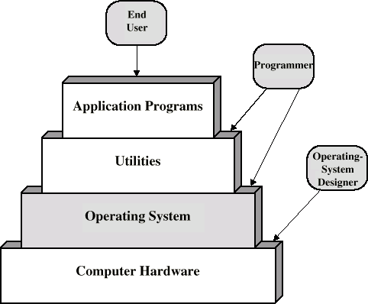
Layers and Views of a Computer System

Slide 4
Operating System Services
Program creation
Program execution
Access to I/O devices
Controlled access to files
System access
Error detection and response
Accounting

Slide 5
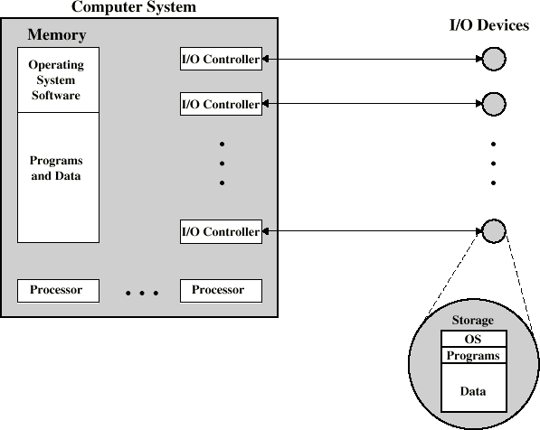
O/S as a Resource Manager

Slide 6
Types of Operating System
Interactive
Batch
Single program (Uni-programming)
Multi-programming (Multi-tasking)

Slide 7
Early Systems
Late 1940s to mid 1950s
No Operating System
Programs interact directly with hardware
Two main problems:
Scheduling
Setup time

Slide 8
Simple Batch Systems
Resident Monitor program
Users submit jobs to operator
Operator batches jobs
Monitor controls sequence of events to process batch
When one job is finished, control returns to Monitor which reads next job
Monitor handles scheduling

Slide 9
Job Control Language
Instructions to Monitor
Usually denoted by $
e.g.
$JOB
$FTN
...
$LOAD
$RUN
...
$END
Some Fortran instructions
Some data

Slide 10
Desirable Hardware Features
Memory protection
To protect the Monitor
Timer
To prevent a job monopolizing the system
Privileged instructions
Only executed by Monitor
e.g. I/O
Interrupts
Allows for relinquishing and regaining control

Slide 11
Multi-programmed Batch Systems
I/O devices very slow
When one program is waiting for I/O, another can use the CPU

Slide 12
Single Program

Slide 13
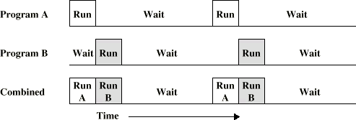
Multi-Programming with Two Programs

Slide 14
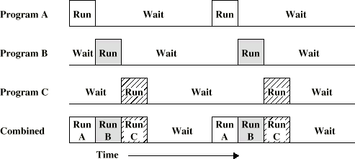
Multi-Programming with Three Programs

Slide 15
Time Sharing Systems
Allow users to interact directly with the computer
i.e. Interactive
Multi-programming allows a number of users to interact with the computer

Slide 16
Scheduling
Key to multi-programming
Long term
Medium term
Short term
I/O

Slide 17
Long Term Scheduling
Determines which programs are submitted for processing
i.e. controls the degree of multi-programming
Once submitted, a job becomes a process for the short term scheduler
(or it becomes a swapped out job for the medium term scheduler)

Slide 18
Medium Term Scheduling
Part of the swapping function (later…)
Usually based on the need to manage multi- programming
If no virtual memory, memory management is also an issue

Slide 19
Short Term Scheduler
Dispatcher
Fine grained decisions of which job to execute next
i.e. which job actually gets to use the processor in the next time slot

Slide 20
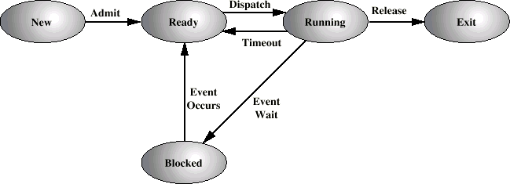
Process States

Slide 21
Process Control Block
Identifier
State
Priority
Program counter
Memory pointers
Context data
I/O status
Accounting information

Slide 22
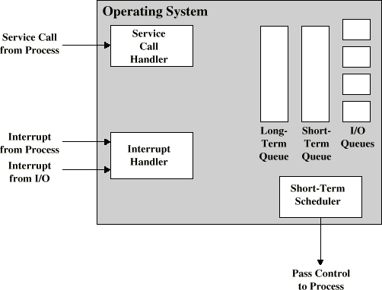
Key Elements of O/S

Slide 23
Process Scheduling
Process Request
Short-Term Queue
End
Long-Term Queue
CPU
I/O
I/O Queue
I/O
I/O Queue
I/O
I/O Queue

Slide 24
Memory Management
Uni-program
Memory split into two
One for Operating System (monitor)
One for currently executing program
Multi-program
“User” part is sub-divided and shared among active processes

Slide 25
Swapping
Problem: I/O is so slow compared with CPU that even in multi-programming system, CPU can be idle most of the time
Solutions:
Increase main memory
Expensive
Leads to larger programs
Swapping

Slide 26
What is Swapping?
Long term queue of processes stored on disk
Processes “swapped” in as space becomes available
As a process completes it is moved out of main memory
If none of the processes in memory are ready (i.e. all I/O blocked)
Swap out a blocked process to intermediate queue
Swap in a ready process or a new process
But swapping is an I/O process...

Slide 27
Partitioning
Splitting memory into sections to allocate to processes (including Operating System)
Fixed-sized partitions
May not be equal size
Process is fitted into smallest hole that will take it (best fit)
Some wasted memory
Leads to variable sized partitions

Slide 28
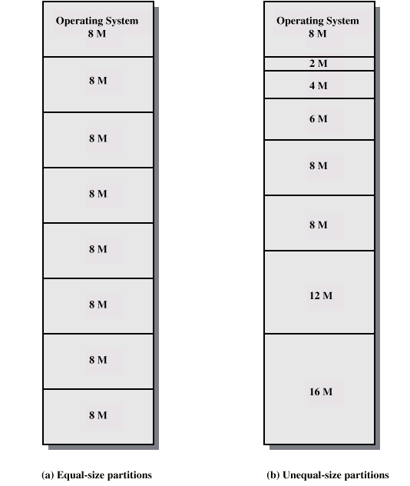
Fixed Partitioning

Slide 29
Variable Sized Partitions (1)
Allocate exactly the required memory to a process
This leads to a hole at the end of memory, too small to use
Only one small hole - less waste
When all processes are blocked, swap out a process and bring in another
New process may be smaller than swapped out process
Another hole

Slide 30
Variable Sized Partitions (2)
Eventually have lots of holes (fragmentation)
Solutions:
Coalesce - Join adjacent holes into one large hole
Compaction - From time to time go through memory and move all hole into one free block (c.f. disk de- fragmentation)

Slide 31
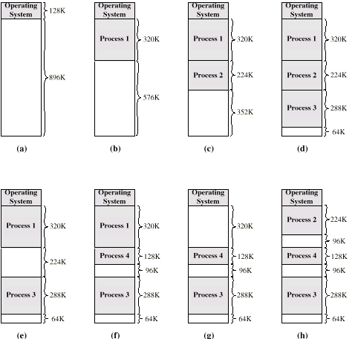
Effect of Dynamic Partitioning

Slide 32
Relocation
No guarantee that process will load into the same place in memory
Instructions contain addresses
Locations of data
Addresses for instructions (branching)
Logical address - relative to beginning of program
Physical address - actual location in memory (this time)
Automatic conversion using base address

Slide 33
Paging
Split memory into equal sized, small chunks - page frames
Split programs (processes) into equal sized small chunks - pages
Allocate the required number page frames to a process
Operating System maintains list of free frames
A process does not require contiguous page frames
Use page table to keep track
33

Slide 34
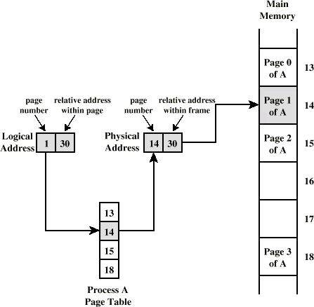
Logical and Physical Addresses
- Paging
34

Slide 35
Virtual Memory
Demand paging
Do not require all pages of a process in memory
Bring in pages as required
Page fault
Required page is not in memory
Operating System must swap in required page
May need to swap out a page to make space
Select page to throw out based on recent history
35

Slide 36
Thrashing
Too many processes in too little memory
Operating System spends all its time swapping
Little or no real work is done
Disk light is on all the time
Solutions
Good page replacement algorithms
Reduce number of processes running
Fit more memory
36

Slide 37
Bonus
We do not need all of a process in memory for it to run
We can swap in pages as required
So - we can now run processes that are bigger than total memory available!
Main memory is called real memory
User/programmer sees much bigger memory - virtual memory
37

Slide 38
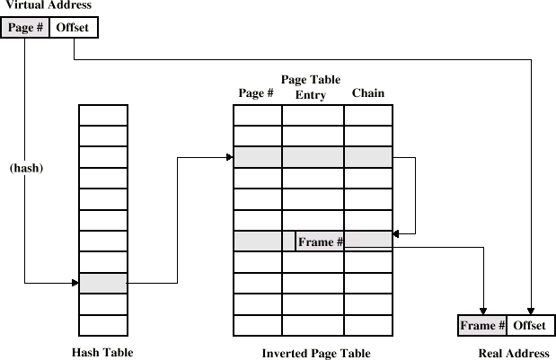
Page Table Structure
38

Slide 39
Segmentation
Paging is not (usually) visible to the programmer
Segmentation is visible to the programmer
Usually different segments allocated to program and data
May be a number of program and data segments
39

Slide 40
Advantages of Segmentation
Simplifies handling of growing data structures
Allows programs to be altered and recompiled independently, without re-linking and re-loading
Lends itself to sharing among processes
Lends itself to protection
Some systems combine segmentation with paging
40

Slide 41
Required Reading
Stallings chapter 7
Stallings, W. Operating Systems, Internals and Design Principles, Prentice Hall 1998
Loads of Web sites on Operating Systems
41

