Slide 1
Computer Arithmetic

Slide 2
Arithmetic & Logic Unit
Does the calculations
Everything else in the computer is there to service this unit
Handles integers
May handle floating point (real) numbers
May be separate FPU (maths co-processor)
May be on chip separate FPU (486DX +)

Slide 3
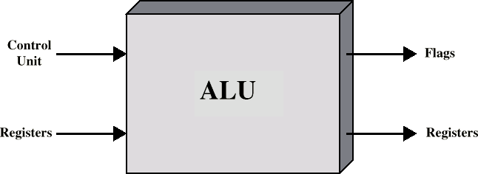
ALU Inputs and Outputs

Slide 4
Integer Representation
Only have 0 & 1 to represent everything
Positive numbers stored in binary
e.g. 41=00101001
No minus sign
No period
Sign-Magnitude
Two’s compliment

Slide 5
Sign-Magnitude
Left most bit is sign bit
0 means positive
1 means negative
+18 = 00010010
 -18 = 10010010
Problems
Need to consider both sign and magnitude in arithmetic
Two representations of zero (+0 and -0)

Slide 6
Two’s Compliment
+3 = 00000011
+2 = 00000010
+1 = 00000001
+0 = 00000000
 -1 = 11111111
 -2 = 11111110
 -3 = 11111101

Slide 7
Benefits
One representation of zero
Arithmetic works easily (see later)
Negating is fairly easy
3 = 00000011
Boolean complement gives 11111100
Add 1 to LSB 11111101

Slide 8
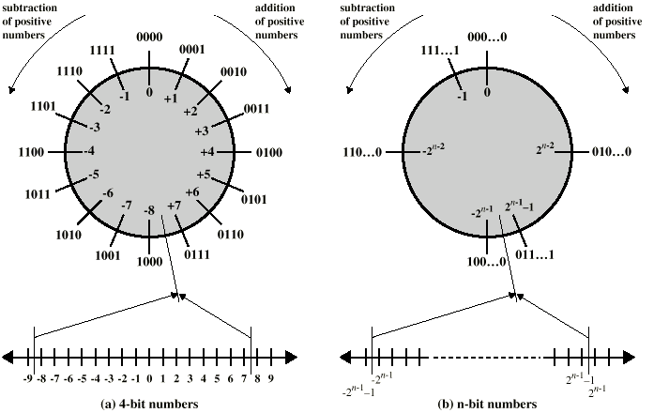
Geometric Depiction of Twos Complement Integers

Slide 9
Negation Special Case 1
 0 = | 00000000
Bitwise not | 11111111
Add 1 to LSB | +1
Result | 1 00000000
Overflow is ignored, so:
- 0 = 0 √

Slide 10
Negation Special Case 2
-128 = | 10000000
bitwise not | 01111111
Add 1 to LSB | +1
Result | 10000000
So:
-(-128) = -128 X
Monitor MSB (sign bit)
It should change during negation

Slide 11
Range of Numbers
8 bit 2s compliment
+127 = 01111111 = 2⁷ -1
 -128 = 10000000 = -2⁷
16 bit 2s compliment
+32767 = 011111111 11111111 = 2¹⁵ - 1
 -32768 = 100000000 00000000 = -2¹⁵

Slide 12
Conversion Between Lengths
Positive number pack with leading zeros
+18 = 00010010
+18 = 00000000 00010010
Negative numbers pack with leading ones
-18 = 10010010
-18 = 11111111 10010010
i.e. pack with MSB (sign bit)

Slide 13
Addition and Subtraction
Normal binary addition
Monitor sign bit for overflow
Take twos compliment of substahend and add to minuend
i.e. a - b = a + (-b)
So we only need addition and complement circuits

Slide 14
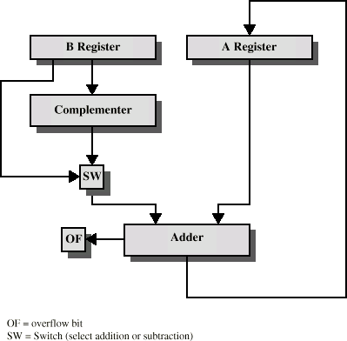
Hardware for Addition and Subtraction

Slide 15
Multiplication
Complex
Work out partial product for each digit
Take care with place value (column)
Add partial products

Slide 16
Multiplication Example
 | 1011 | Multiplicand (11 dec)
 | 1101 | Multiplier (13 dec)
 | 1011 | Partial products
 | 0000 | Note: if multiplier bit is 1 copy
 | 1011 | multiplicand (place value)
 | 1011 | otherwise zero
 10001111 Product (143 dec)
 Note: need double length result

Slide 17
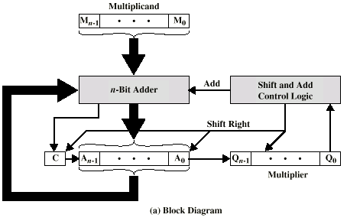
Unsigned Binary Multiplication

Slide 18
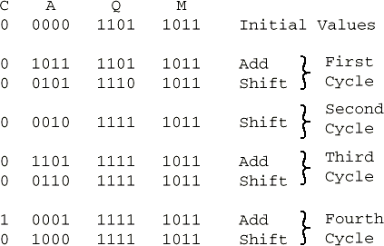
Execution of Example

Slide 19
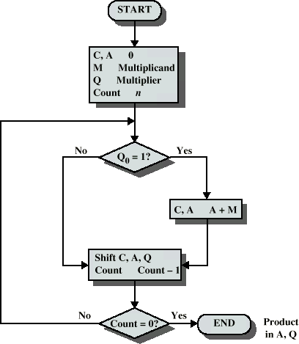
Flowchart for Unsigned Binary Multiplication

Slide 20
Multiplying Negative Numbers
This does not work!
Solution 1
Convert to positive if required
Multiply as above
If signs were different, negate answer
Solution 2
Booth’s algorithm

Slide 21
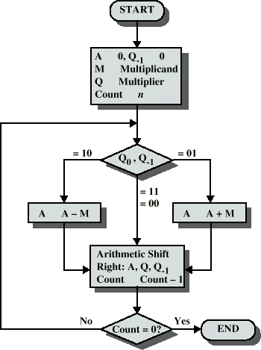
Booth’s Algorithm

Slide 22
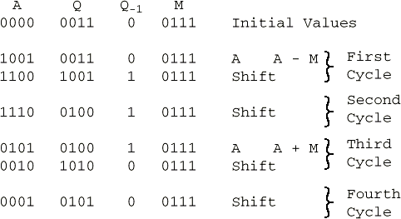
Example of Booth’s Algorithm

Slide 23
Division
More complex than multiplication
Negative numbers are really bad!
Based on long division

Slide 24
Division of Unsigned Binary Integers
00001101
Quotient
Dividend
Divisor
1011 10010011
1011 001110
1011
Partial Remainders
001111
1011
100
Remainder

Slide 25
Division Algorithm
start
A = 0
M = Divisor Q = Dividend Count = n
Shift Left A,Q A = A - M
N
Y
Q₀ = 0
A = A + M
Q = 1
A<0
?
0
Count = Count - 1
N
Y
Count = 0
?
Stop

Slide 26
Example
A | Q | M = 0011
0000 | 0111 | Initial value
0000 | 1110 | Shift
1101 |  | Subtract
0000 | 1110 | Restore
0001 | 1100 | Shift
1110 |  | Subtract
0001 | 1100 | Restore
0011 | 1000 | Shift
0000 |  | Subtract
0000 | 1001 | Set Q₀ = 1
0001 | 0010 | Shift
1110 |  | Subtract
0001 | 0010 | Restore

Slide 27
Real Numbers
Numbers with fractions
Could be done in pure binary
1001.1010 = 2⁴ + 2⁰ +2⁻¹ + 2⁻³ =9.625
Where is the binary point?
Fixed?
Very limited
Moving?
How do you show where it is?

Slide 28
Floating Point
Sign bit
Biased Exponent
Significand or Mantissa
+/- .significand x 2^{exponent}
Misnomer
Point is actually fixed between sign bit and body of mantissa
Exponent indicates place value (point position)

Slide 29
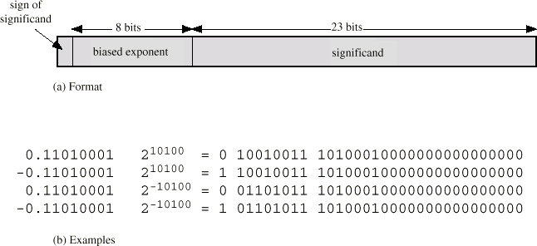
Floating Point Examples

Slide 30
Signs for Floating Point
Mantissa is stored in 2s compliment
Exponent is in excess or biased notation
e.g. Excess (bias) 128 means
8 bit exponent field
Pure value range 0-255
Subtract 128 to get correct value
Range -128 to +127

Slide 31
Normalization
FP numbers are usually normalized
i.e. exponent is adjusted so that leading bit (MSB) of mantissa is 1
Since it is always 1 there is no need to store it
(c.f. Scientific notation where numbers are normalized to give a single digit before the decimal point
e.g. 3.123 x 10³)

Slide 32
FP Ranges
For a 32 bit number
8 bit exponent
+/- 2²⁵⁶ ≈ 1.5 x 10⁷⁷
Accuracy
The effect of changing lsb of mantissa
23 bit mantissa 2⁻²³ ≈ 1.2 x 10⁻⁷
About 6 decimal places

Slide 33
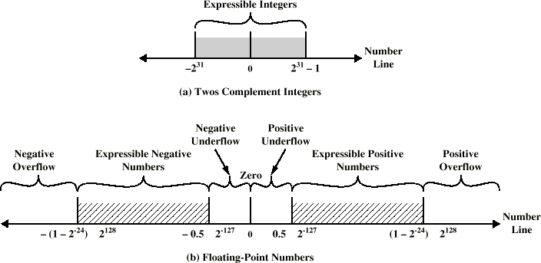
Expressible Numbers

Slide 34
IEEE 754
Standard for floating point storage
32 and 64 bit standards
8 and 11 bit exponent respectively
Extended formats (both mantissa and exponent) for intermediate results

Slide 35
FP Arithmetic +/-
Check for zeros
Align significands (adjusting exponents)
Add or subtract significands
Normalize result

Slide 36
FP Arithmetic x/÷
Check for zero
Add/subtract exponents
Multiply/divide significands (watch sign)
Normalize
Round
All intermediate results should be in double length storage

Slide 37
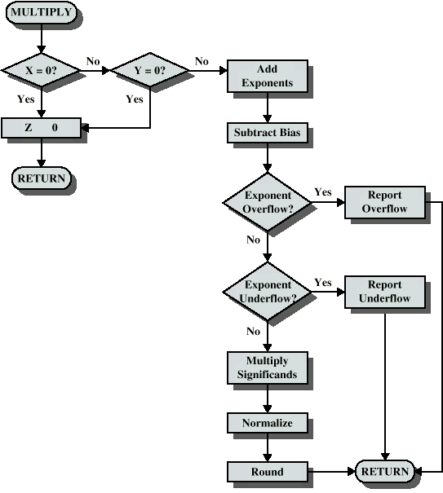
Floating Point Multiplication

Slide 38
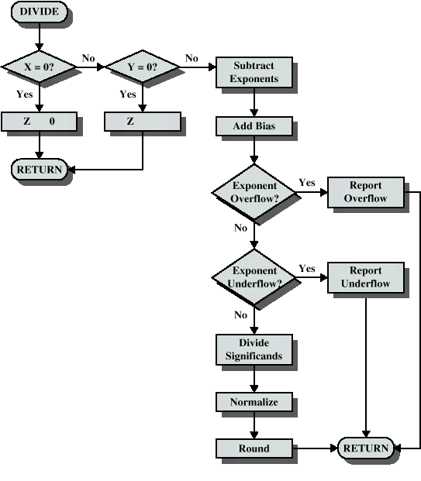
Floating Point Division

Slide 39
Required Reading
Stallings Chapter 8
IEEE 754 on IEEE Web site

